Slide 1
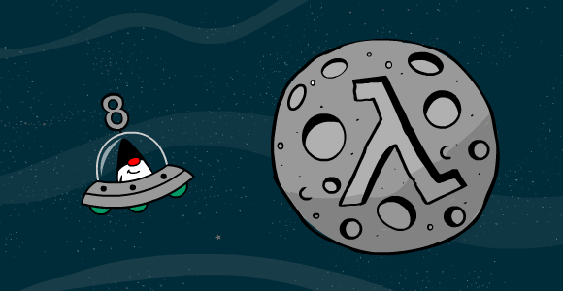
LAMBDA EXPRESSIONS
FUNCTIONAL PROGRAMMING IN JAVA

Slide 2
Java 8 is the single largest ever upgrade in the history of Java programming model ... even larger than generics

Slide 3
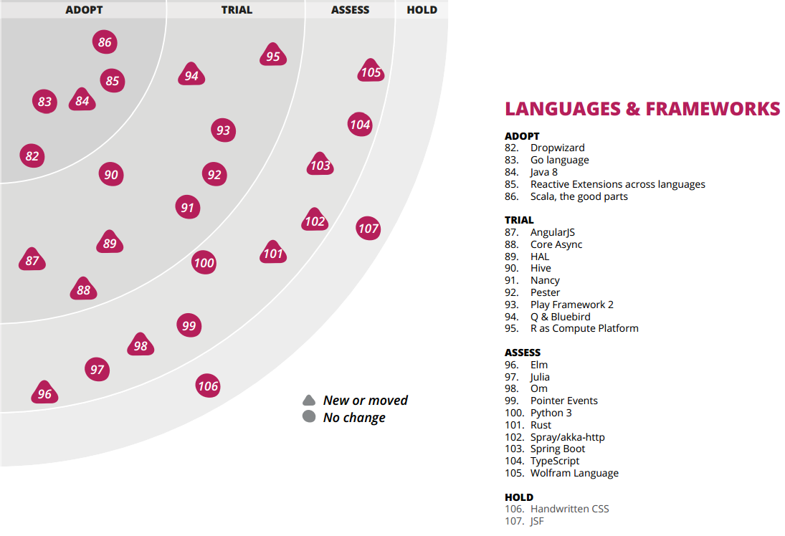

Slide 4
Imperative Programming
Programs written in imperative programming languages consist of
  A program state
  Instructions that change the program state
Noisy and Low level i.e) several moving parts
Mutable variables leading to concurrency bugs
Side effects make debugging harder
we often wish the language were a tad more intelligent.. we could then tell it declaratively—what we want rather than delve into how to do it. Thankfully, Java can now help us do that.

Slide 5
Imperative vs Declarative
Imperative -> How to achieve our goal
  Take the next customer from a list.
  If the customer lives in Spain, show their details.
  If there are more customers in the list, go to the beginning
Declarative -> What we want to achieve
  Show customer details of every customer living in Spain
See notes
Notes:
Imperative:
boolean found = false;
for(String city : cities) {
if(city.equals("Chicago")) {
found = true;
break;
}
}
System.out.println("Found chicago?:" + found);
Declarative:
System.out.println("Found chicago?:" + cities.contains("Chicago"));

Slide 6
Declarative Programming
Describe the solution space
Provide knowledge required to get there
Don’t describe steps needed to get there
final Function<Person, Integer> byAge = person -> person.getAge();
final Function<Person, String> byTheirName = person -> person.getName();
people.stream()
.sorted(comparing(byAge)
.thenComparing(byTheirName))
.collect(toList()));

Slide 7
Ceremony vs Essence
Ceremony: code that is unrelated to the task at hand. Often vastly outweighs the code that is actually getting work done.
Many forms of ceremony come from unnecessary special cases or limitations at the language level
  factory patterns
  dependency injection
  getters and setters
  annotations
  verbose exception handling

Slide 8
Ceremony vs Essence
Essence: code that is
  elegant and concise
  free of low-level operations
  less prone to errors
  more efficient
  easier to optimize, enhance, and parallelize

Slide 9
Functional Programming
Functions are first class citizens in a functional programming language. They exists on their own.
Functional-style code has a higher signal-to-noise ratio; we write fewer lines of code, but each line or expression achieves more.
You can assign them to a variable and pass them as arguments to other functions.
Lambda expression adds that missing link of functional programming to Java. Lambda expression (sort of) let us have functions as first class citizen.

Slide 10
Object Oriented vs Functional Programming
Object Oriented:
  Pass objects to methods
  Create objects within methods
  Return objects from within methods
We can write code in functional style using higher-order functions.
Higher-order functions:
  Pass functions to functions
  Create functions within functions
  Return functions from functions

Slide 11
Why functional programming?
• The functional-style version is more concise
• The code is more expressive, easier to understand and maintain
There is no explicit mutation in our code. Fewer mutations leads to fewer errors in code
The functional version can easily be parallelized
The functional-style version is intuitive—code reads more like how we’d state the problem.

Slide 12
Higher-order functions
In mathematics and computer science, a higher-order function is a function that does at least one of the following:
  takes one or more functions as an input
  outputs a function
prices.stream()
.filter(price -> price.compareTo(BigDecimal.valueOf(20)) > 0)
.map(price -> price.multiply(BigDecimal.valueOf(0.9)))
.reduce(BigDecimal.ZERO, BigDecimal::add);

Slide 13
Lambda Expressions
In previous example we’re sending a function, price -> price.multiply(BigDecimal.valueOf(0.9)), as an argument to map. The function being passed is created just in time, at the point of call to the higher-order function map.
Generally a function has a body, a name, a parameter list, and a return type. The just-in-time function created here has a parameter list followed by an arrow (->), and then the short body and return type is implicit.
This anonymous function is called Lambda Expression.

Slide 14
Method References
The Java compiler will take either a lambda expression or a reference to a method where an implementation of a functional interface is expected.
With this feature, a short String::toUpperCase can replace name -> name.toUpperCase()
friends.stream()
.map(String::toUpperCase)
.forEach(name -> System.out.println(name));

Slide 15
Functional Interface
A functional interface is an interface with one abstract unimplemented method. Equivalent to single-method interfaces like Runnable, Callable, Comparable etc.
A functional interface may also have zero or more default methods, which are implemented right within the interface.
JDK 8 has more of these types of interfaces—Function, Predicate, Consumer, Supplier

Slide 16
connecting the dots..
A lambda expression is like syntactic sugar for an anonymous class with one method whose type is inferred. When we pass a lambda expression to a method, the compiler will convert the lambda expression to an instance of the appropriate functional interface.
If a method takes a functional interface as a parameter, then we can pass the following:
  An anonymous inner class, the old-fashioned way
  A lambda expression, like we did when we called the map() method
  A method or constructor reference
See notes
Notes:
In a typical use case, a Java API defines an interface, sometimes described as a "callback interface," expecting the user to provide an instance of the interface when invoking the API. For example:
public interface ActionListener {
void actionPerformed(ActionEvent e);
}
Rather than declaring a class that implements ActionListener for the sole purpose of allocating it once at an invocation site, a user typically instantiates the implementing class inline, anonymously:
button.addActionListener(new ActionListener() {
public void actionPerformed(ActionEvent e) {
ui.dazzle(e.getModifiers());
}
});
For example, the following lambda expression is an ActionListener:
button.addActionListener(e -> ui.dazzle(e.getModifiers()));

Slide 17
Examples to illustrate ..
Evolution 1: Habitual way. Imperative. Uses External Iterator
for(int i = 0; i < friends.size(); i++) {
System.out.println(friends.get(i));
}
Evolution 2: Less ceremony. Imperative. Still uses External Iterator
for(String name : friends) {
System.out.println(name);
}
Evolution 3: Using an Anonymous inner class syntax. Uses Internal Iterator i.e)forEach
friends.forEach(new Consumer<String>() {
public void accept(final String name) {
System.out.println(name);
}
});
Evolution 4: Replacing Anonymous inner class with a Lambda Expression
friends.forEach((final String name) -> System.out.println(name));
Evolution 5: Type inference to reduce noise
friends.forEach(name -> System.out.println(name));
Evolution 6: Using Method Reference, an alternate to Lambda Expression
friends.forEach(System.out::println);

Slide 18
Internal vs External Iterator
External Iterator:
  Imperative. We explicitly control the iteration with them, indicating where to start and where to end
  Uses the Iterator interface and calls into its hasNext() and next() methods.The for loops are inherently sequential and are quite difficult to parallelize
Internal Iterator:
  Declarative. The underlying function will take care of managing the iteration

Slide 19
More on .. Internal Iterator
Internal iterators make it convenient to traverse collections, transform collections without enduring mutability, and select elements from collections without much effort
With an internal iteration we willfully turn over most of the hows to the underlying library so we can focus on the essential whats.

Slide 20
Streams
java.util.stream package offer rich aggregate operations on collections, arrays, and other data sources in a declarative, expressive, and parallel-friendly manner.
A Stream is much like an iterator on a collection of objects and provides some nice fluent functions such as map, filter, reduce, forEach, collect, sorted, min, max, concat, findFirst
The method stream() is available on all collections in JDK 8 and it wraps the collection into an instance of Stream.

Slide 21
More on .. Streams
Exploiting parallelism by writing multithreaded code (using the Threads API from previous versions of Java) is difficult
Stream-based parallelism encourages a functional programming style where synchronized is rarely used
Java 8 also addresses both problems (boilerplate and obscurity involving processing collections and difficulty leveraging multicore) with the Streams API (java.util.stream)

Slide 22
filter() method
The filter() method expects a lambda expression that returns a boolean result.
If the lambda expression returns a true, the element in context while executing that lambda expression is added to a result collection; it’s skipped otherwise.
Finally the method returns a Stream with only elements for which the lambda expression yielded a true.
See notes
Notes:
Imperative:
final List<String> startsWithN = new ArrayList<String>();
for(String name : friends) {
if(name.startsWith("N")) {
startsWithN.add(name);
}
}
System.out.println(String.format("Found %d names", startsWithN.size()));
Declarative:
final List<String> startsWithN =
friends.stream()
.filter(name -> name.startsWith("N"))
.collect(Collectors.toList());
System.out.println(String.format("Found %d names", startsWithN.size()));

Slide 23
map() method
The filter() method returns an iterator just like the map() method does, but the similarity ends there. The Stream’s map() method can map or transform a sequence of input to a sequence of output
Whereas the map() method returns a collection of the same size as the input collection, the filter() method returns a subset.
The map() method of a new Stream interface can help us avoid mutability and make the code concise.
See notes
Notes:
friends.stream()
.map(name -> name.toUpperCase())
.forEach(name -> System.out.print(name + " "));

Slide 24
Predicate (functional interface)
it’s possible to store the lambda expression in an explicit reference of type Predicate and then pass it to the function. This is an easy way to remove the duplication.
The filter() method, the receiver of the lambda expression in the previous example, takes a reference to a java.util.function.Predicate functional interface.
Here, the Java compiler works its magic to synthesize an implementation of the Predicate’s test() method from the given lambda expression.
See notes
Notes:
final Predicate<String> startsWithN = name -> name.startsWith("N");
final long countFriendsStartN =
friends.stream()
.filter(startsWithN)
.count();
final long countEditorsStartN =
editors.stream()
.filter(startsWithN)
.count();
final long countComradesStartN =
comrades.stream()
.filter(startsWithN)
.count();

Slide 25
Lexical Scoping & Closure
Lexical scoping is a powerful technique that lets us cache values provided in one context for use later in another context.
From within a lambda expression we can access variables that are in the enclosing method’s scope.Lambda expressions that bind to variables in enclosing scopes are called Closures. For example, the variable letter in the checkIfStartsWith() is accessed within the lambda expression.
public static Predicate<String> checkIfStartsWith(final String letter) {
return name -> name.startsWith(letter);
} See notes
Notes:
public static Predicate<String> checkIfStartsWith(final String letter) {
return name -> name.startsWith(letter);
}
final Predicate<String> startsWithN = name -> name.startsWith("N");
final Predicate<String> startsWithB = name -> name.startsWith("B");
final long countFriendsStartN =
friends.stream()
.filter(startsWithN).count();
final long countFriendsStartB =
friends.stream()
.filter(startsWithB).count();
System.out.println(countFriendsStartN);
System.out.println(countFriendsStartB);

Slide 26
Function (Functional Interface)
A Predicate<T> takes in one parameter of type T and returns a boolean result to indicate a decision for whatever check it represents.
Methods like filter() that evaluate candidate elements take in a Predicate as their parameters.
A Function<T, R> represents a function that takes a parameter of type T and returns a result of type R. This is more general than a Predicate that always returns a boolean.
We can use a Function anywhere we want to transform an input to another value, so it’s quite logical that the map() method uses it as its parameter. See notes
Notes:
final Function<String, Predicate<String>> startsWithLetter =
letter -> name -> name.startsWith(letter);
final long countFriendsStartN =
friends.stream()
.filter(startsWithLetter.apply("N")).count();

Slide 27
Protection from Null Pointer Exception
The Optional class is useful whenever there may be a result.
It protects us from getting a NullPointerException by accident and makes it quite explicit to the reader that “no result found” is a possible outcome.
We can inquire if an object is present by using the isPresent() method, and we can obtain the current value using its get() method.
Alternatively, we could suggest a substitute value for the missing instance, using the method orElse() See notes
Notes:
public static void pickName( final List<String> names, final String startingLetter) {
final Optional<String> foundName = names.stream()
.filter(name ->name.startsWith(startingLetter))
.findFirst();
System.out.println(String.format("A name starting with %s: %s",
startingLetter, foundName.orElse("No name found")));
foundName.ifPresent(name -> System.out.println("Hello " + name));
}
public static void main(final String[] args) {
pickName(friends, "N");
pickName(friends, "Z");
}

Slide 28
reduce() method
We can use the reduce() method to compare two elements against each other and pass along the result for further comparison with the remaining elements in the collection.
Much like the other higher-order functions on collections we’ve seen so far, the reduce() method iterates over the collection.
In addition, it carries forward the result of the computation that the lambda expression returned.
See notes
Notes:
final Optional<String> aLongName =
friends.stream()
.reduce((name1, name2) ->
name1.length() >= name2.length() ? name1 : name2);
aLongName.ifPresent(name ->
System.out.println(String.format("A longest name: %s", name)));
The lambda expression we’re passing to the reduce() method takes two parameters, name1 and name2, and returns one of them based on the length. The reduce() method has no clue about our specific intent. That concern is separated from this method into the lambda expression that we pass to it— this is a lightweight application of the strategy pattern

Slide 29
collect() method
The collect() method does the reduction but delegates the actual implementation or target to a collector.
A collector acts as a sink object to receive elements passed by the collect() method and stores it in a desired format: ArrayList, String, and so on.
For example, We could drop the transformed elements into an ArrayList
See notes
Notes:
System.out.println(
friends.stream().map(String::toUpperCase).collect(joining(", ")));

Slide 30
sort method()
sorted() method will return a sorted collection.
This method takes a Comparator as its parameter. Since Comparator is a functional interface, we can conveniently pass in a lambda expression.
While the reduce() method trickles the list down to one value. The sorted() method, on the other hand, uses the result of the comparison to perform the ordering.
See notes
Notes:
List<Person> ascendingAge =
people.stream()
.sorted((person1, person2) -> person1.ageDifference(person2))
.collect(toList());
printPeople("Sorted in ascending order of age: ", ascendingAge);

Slide 31
..as lightweight design tool
Lambda expressions are not just a language feature; they turn into a very powerful yet lightweight design tool.
Instead of spending the effort to create a hierarchy of interfaces and classes, we can reuse functional interfaces and pass around lambda expressions and method references where possible
This technique can help us easily create delegates to quickly implement the strategy pattern at both the methods and the classes level. See notes
Notes:
interface Strategy{
public void performTask();
}
class LazyStratgey implements Strategy{
public void performTask() {
System.out.println("Perform task a day before deadline!");
}
}
class ActiveStratgey implements Strategy{
public void performTask() {
System.out.println("Perform task now!");
}
}
public class StartegyPatternOldWay {
public static void main(String[] args) {
List<Strategy> strategies =
Arrays.asList(
new LazyStratgey(),
new ActiveStratgey()
)
for(Strategy stg : strategies){
stg.performTask();
} }

Slide 32
..as lightweight design tool
public class StrategyPatternOnSteroids {
public static void main(String[] args) {
System.out.println("Strategy pattern on Steroids");
List<Strategy> strategies =
Arrays.asList(
() -> {System.out.println("Perform task a day before deadline!");},
() -> {System.out.println("Perform task now!");}
);
strategies.forEach((elem) -> elem.performTask());
}
}

Slide 33
Gain performance.. by being lazy
In Java we often execute code eagerly. The arguments are evaluated right at the time of method calls
But delaying commitments until the last responsible moment is a good agile practice.
When executing code, we can gain in performance by being just a little lazy.
Eager is simple, but lazy is effective.The main objective is to reduce the execution of code to the bare minimum—especially the expensive code—and speed up the execution.

Slide 34
Lazy Evaluation
While Java uses lazy or normal order when evaluating logical operators, it uses eager or applicative order when evaluating method arguments.
All the arguments to methods are fully evaluated before a method is invoked. If the method doesn’t use all of the passed arguments, the program has wasted time and effort executing them.
We can use lambda expressions to postpone the execution of select arguments.

Slide 35
Optimizing Recursion
Recursive methods will often throw a StackOverflowException when processing big sets.
TCO(Tail Call Optimization) lets us convert regular recursive calls into tail calls to make recursions practical for large inputs.
With the help of Lambda Expressions, we can implement Tail Call Optimization in Java.
Thereby, We can enjoy the power of recursion without the concern of blowing up the stack.

Slide 36
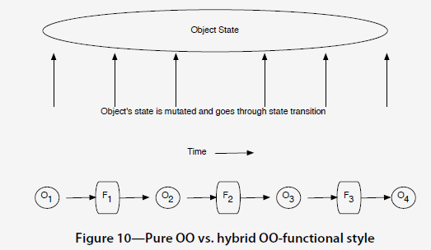
Function Composition
In pure OO, over time an object’s state goes through transitions. If we combine OO with the functional style, we can instead transform objects by passing lightweight objects through a series of cohesive functions.

Slide 37
Function Composition .. Benefits
Using function chaining, we can create a chain of functions so the results of computations flow smoothly from one function into the next.
.The code begins to read like the problem statement, making it easier to follow..
The lack of mutability reduces the chance of errors and makes it easier to parallelize the code.
We can alter a few links in the chain and easily alter the behavior along the way.

Slide 38
Parallelize Execution
Race conditions arise largely from shared mutability.
By preserving immutability and avoiding side effects we can easily parallelize execution of parts of the chain’s operations and gain on speed.
Going from sequential to parallel was as simple as toggling a switch. Instead of Stream, we use parallelStream.

Slide 39
Adopting Functional Style .. Tips
More Declarative, Less Imperative
Favor Immutability
Reduce Side Effects
Prefer Expressions Over Statements
Design with Higher-Order Functions

Slide 40
More links..
http://cr.openjdk.java.net/~briangoetz/lambda/lambda-state-final.html
https://www.youtube.com/watch?v=MLksirK9nnE [Brian Goetz - "Lambdas in Java: A peek under the hood"]
http://research.google.com/archive/mapreduce.html

